Slide 1
IT252 Database systems
Introduction: Databases and Database Users
Dr. Anand Kumar M
Assistant Professor
Dept of IT
NITK

Slide 2
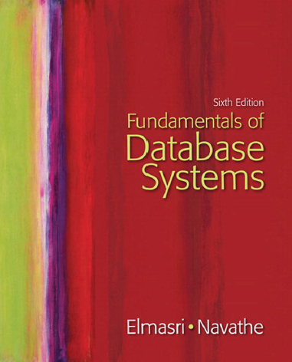

Slide 3
Introduction: Databases and Database Users
Why Databases?
Basic Definitions
Typical DBMS Functionality
Example of a Database (UNIVERSITY)
Main Characteristics of the Database Approach
Database Users
Advantages of Using the Database Approach

Slide 4
Why Databases?
Scientists/Data Analyst have to manage huge quantities of data
Those data need to be stored in a consistent way, shared and analyzed
Structured format
Data can be managed and stored using ad-hoc programs (e.g., in Java, c++, …)
Need for writing ad hoc algorithms (e.g. search, sorting)
Programs have to be changed when data change
Databases are a possible solution to this issue

Slide 5
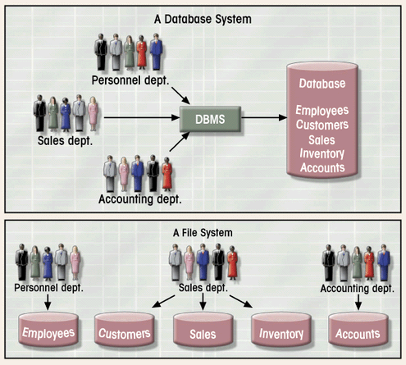
Database System vs. File System
Database Systems: Design, Implementation, & Management: Rob & Coronel

Slide 6
Why Database?
DATA
bases
Structures
Mining
Science
Analytics

Slide 7
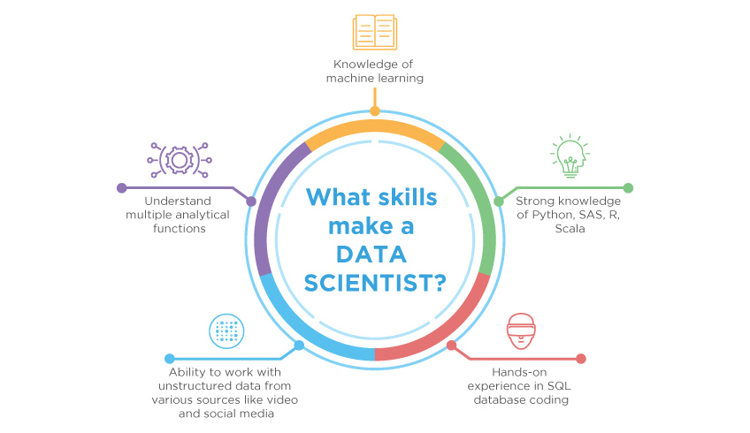
DATA SCIENTIST

Slide 8
What is?
Database
is collection of related data and its metadata organized in a structured format
for optimized information management
Database Management System (DBMS)
is a software that enables easy creation, access, and modification of databases
for efficient and effective database management
Database System
is an integrated system of hardware, software, people, procedures, and data
that define and regulate the collection, storage, management, and use of data within a database environment

Slide 9
Databases and database systems
Databases and database systems are an essential component of life.
Eg

Slide 10
Types of Databases and Database Applications
Slide 1- 10
Traditional Applications:
Numeric and Textual Databases
More Recent Applications:
Multimedia Databases
Geographic Information Systems (GIS)
Data Warehouses
Real-time and Active Databases
Many other applications
Notes:
10

Slide 11
Database implicit properties
A database represents some aspect of the real world, sometimes called the miniworld or the universe of discourse (UoD). Changes to the miniworld are reflected in the database.
A database is a logically coherent collection of data with some inherent meaning. A random assortment of data cannot correctly be referred to as a database.
A database is designed, built, and populated with data for a specific purpose. It has an intended group of users and some preconceived applications in which these users are interested.

Slide 12
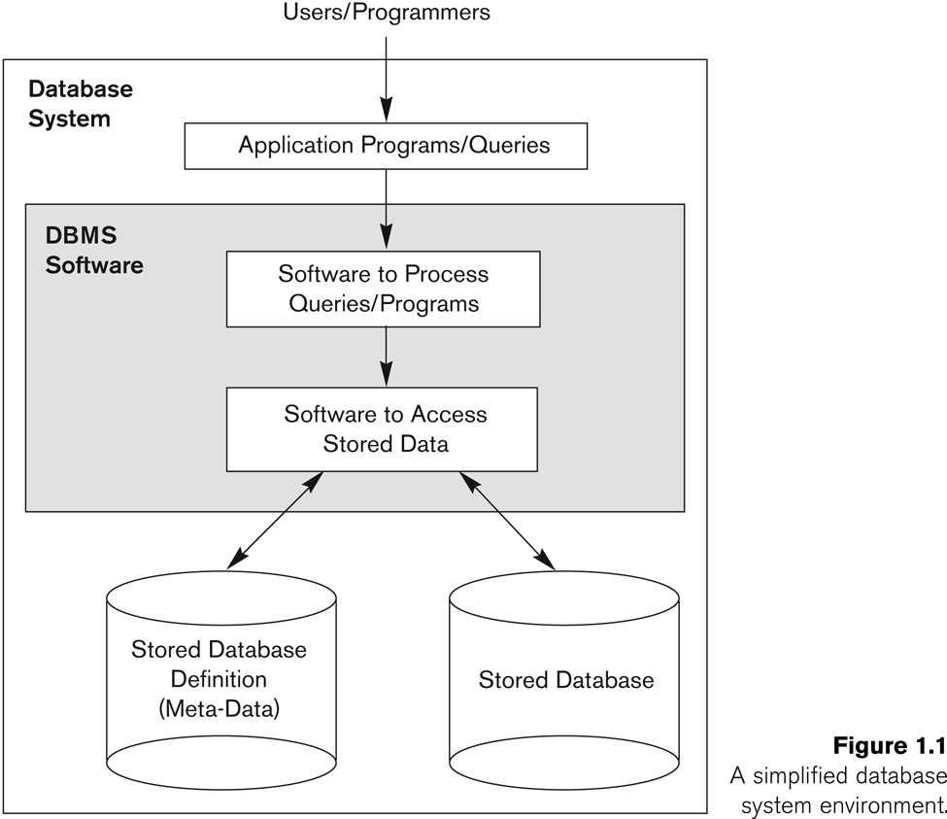
Simplified database system environment

Slide 13
Example of a Database
Mini-world for the example:
Part of a UNIVERSITY environment.
Some mini-world entities:
STUDENTs
COURSEs
SECTIONs (of COURSEs)
(academic) DEPARTMENTs
INSTRUCTORs

Slide 14
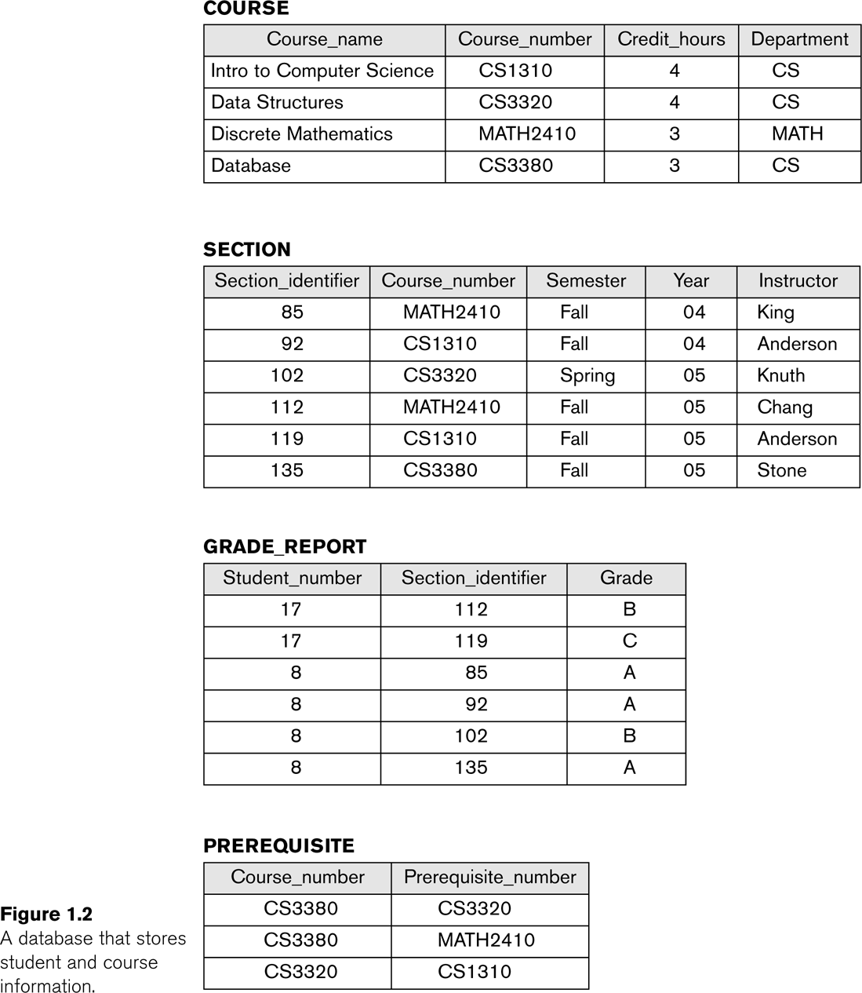
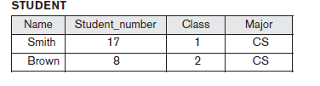
Example of a simple database

Slide 15
Typical DBMS Functionality
Define a particular database in terms of its data types, structures, and constraints – catalog –meta data
Construct or Load/store the initial database contents on a secondary storage medium
Manipulating the database:
Retrieval: Querying, generating reports
Modification: Insertions, deletions and updates to its content
Accessing the database through Web applications
Processing and Sharing by a set of concurrent users and application programs – yet, keeping all data valid and consistent

Slide 16
Manipulation Example
Manipulation involves querying and updating. Examples of queries are as follows:
■ Retrieve the transcript—a list of all courses and grades—of ‘Smith’
Examples of updates include the following:
■ Change the class of ‘Smith’ to sophomore

Slide 17
Typical DBMS Functionality
Other features:
Protection or Security measures to prevent unauthorized access
“Active” processing to take internal actions on data
Presentation and Visualization of data
Maintaining the database and associated programs over the lifetime of the database application.

Slide 18
Characteristics of the Database Approach
Self-describing nature of a database system
Insulation between programs and data, and data abstraction
Support of multiple views of the data
Sharing of data and multiuser transaction processing

Slide 19
Main Characteristics of the Database Approach
Self-describing nature of a database system:
Data base + complete definition or description of the database structure and constraints
A DBMS catalog stores the description of a particular database (e.g. data structures and types)
The description is called meta-data.
This allows the DBMS software to work with different database applications.
traditional file systems, constrained to work with only one specific database, whose structure is declared in the application programs.

Slide 20
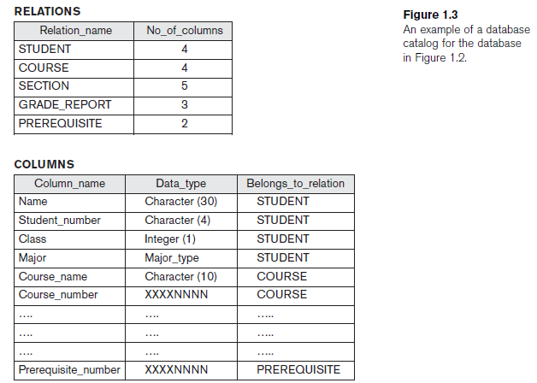
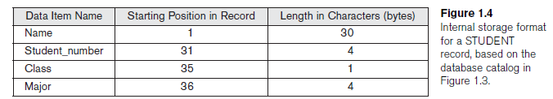
Catalog

Slide 21
Characteristics of the Database Approach
Insulation between programs and data:
In traditional file processing, the structure of data files is embedded in the application programs, so any changes to the structure of a file may require changing all programs that access that file
structure of data files is stored in the DBMS catalog separately from the access programs - Called program-data independence.
Allows changing data structures and storage organization without having to change the DBMS access programs.-
program-operation independence
A data model (conceptual representation) is used to hide storage details and present the users with a conceptual view of the database.

Slide 22
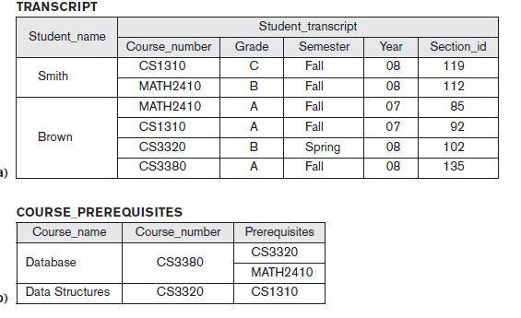
Main Characteristics of the Database Approach (continued)
Support of multiple views of the data:
Subset – Virtual data
Each user may see a different view of the database, which describes only the data of interest to that user.

Slide 23
Main Characteristics of the Database Approach (continued)
Sharing of data and multi-user transaction processing:
Allowing a set of concurrent users (several users trying to update the same data) to retrieve from and to update the database
Concurrency control within the DBMS guarantees that each transaction is correctly executed or aborted
The isolation property ensures that each transaction appears to execute in isolation from other transactions, even though hundreds of transactions may be executing concurrently.
The atomicity property ensures that either all the database operations in a transaction are executed or none are.

Slide 24
Advantages of Using the Database Approach
Interacting easily with data using high-level dedicated tools
Controlling redundancy in data storage and in development and maintenance efforts.
Sharing of data among multiple users.
Ensuring consistency of data.
Duplication of Effort and Storage
Restricting unauthorized access to data.
Grades and Financial Data
Providing Persistent Storage - Object-oriented database
impedance mismatch problem, since the data structures provided by the DBMS were incompatible with the programming language’s data structures
Providing storage structures (e.g. indexes) for efficient query processing

Slide 25
Advantages of Using the Database Approach (continued)
Providing backup and recovery services.
Providing multiple interfaces to different classes of users.
GUI and Web GUI- natural language interfaces
Representing complex relationships among data.
Enforcing integrity constraints on the database.

Slide 26
Thank You

